Slide 1
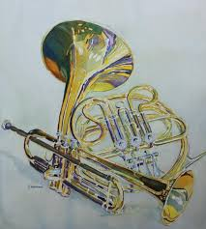
Too Close for Comfort?
Starting Beginning Trumpets and Horn
Presented by
Dr. Etienne Stoupy and Dr. Angela K. Winter

Slide 2
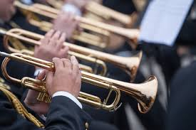
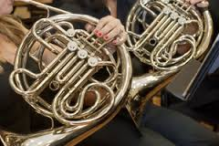
Pedagogy: Close but not the same
Since trumpet and horn are often lumped together in the category of high brass, they are frequently taught with pedagogy that is too closely related.
The differences in approach to these two instruments, particularly in terms of embouchure, have far reaching ramifications.

Slide 3
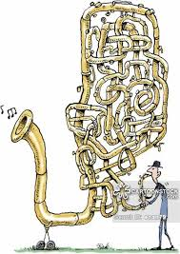
Similarities
All brass instruments share many similarities.
Brass playing is simply vibrating a column of air through a tube.
The main difference amongst brass instruments is the length of that tube.
Air moved past the lips through the tube cause the vibration, thus creating sound.

Slide 4
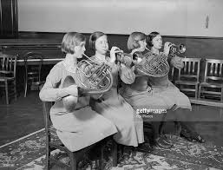
Similarities
Embouchure formation and mouthpiece are particularly similar between high brass instruments, trumpet and horn.

Slide 5
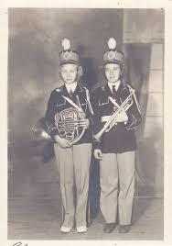
Similarities
The embouchure of these two instruments share many key features.
  Firm corners
  Flat chin
  Flat cheeks
We use many of the same instructional cues to teach the initial buzz.
  Example:
    Say the word “Home”
    Use a small straw as an aid
    Bend the flame of a candle
    Cool hot cocoa

Slide 6
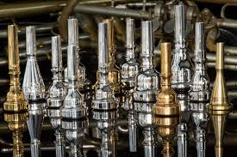
Differences
Mouthpiece
  Design
  Placement
  Angle
Portion of the overtone series used
Length of instrument
Sound concept

Slide 7
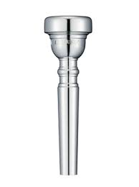
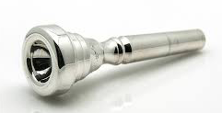
The Mouthpiece: Trumpet
Trumpet mouthpieces, like most trombone, euphonium and tuba mouthpieces, have a thick rim and a more spherical shaped cup.

Slide 8
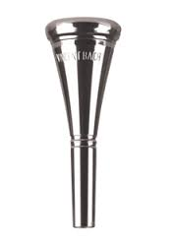

The Mouthpiece: Horn
Horn mouthpieces, unlike other brass mouthpieces, have a funnel shaped cup. The rim is more thin and narrow.

Slide 9
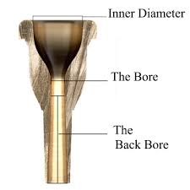
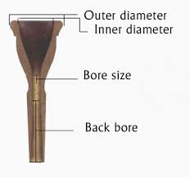
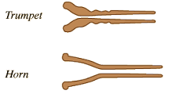

Slide 10

Mouthpiece Placement: Trumpet
Close to 50/50 between upper and bottom lip.
Bud Herseth

Slide 11
Mouthpiece playing for trumpet
Bud Herseth: “Practice on the mouthpiece every day before your regular session. Walk around and play anything musical (no drills) from excerpts to pop tunes. Concentrate on being very musical and these pieces, and most important, on a very LARGE SOUND on the mouthpiece” Posted to TPIN by Steven Fenick, August 1999.
Keith Johnson: “Playing the mouthpiece by itself is an efficient, highly productive means of practice, particularly when specific problems are evident.” The Art of Trumpet Playing by Keith Johnson third edition 2001.

Slide 12

Mouthpiece Placement: Horn
Two-thirds top lip, One-third bottom lip.
  TONE
  FLEXIBILITY
  RANGE
Philip Farkas

Slide 13
Mouthpiece Placement: Horn
TONE
Philip Farkas, The Art of Brass Playing, Rochester, NY: Wind Music, Inc., 1962, p. 32-33.
  “Of all the brass instrument embouchures, the horn player’s is probably the softest, most relaxed and most puckered. This tends to emphasize the heavy, fleshy mound in the center of the upper lip… [It] is logical for the horn player to place the mouthpiece above it rather than try to perch the rim precariously upon it. The thicker condition of the upper lip, when it is the dominating lip in the mouthpiece, seems to give the tone a more mellow, less strident quality. And, of course, this velvety quality is much to be desired in the horn tone.”

Slide 14
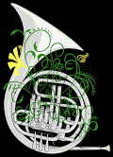
Mouthpiece Placement: Horn
FLEXIBILITY
Wendell Rider, Real World Horn Playing, San Jose, CA: Wendell Rider Publications, 2006, p. 16.
  “The upper lip muscles must be free to move. These are the ‘finesse’ muscles or your embouchure.”
Graphics credit:
Heather David

Slide 15
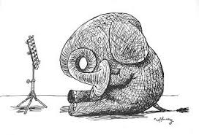
Mouthpiece Placement: Horn
RANGE
John Ericson, Introducing the Horn: Essentials for New Hornists and their Teachers, Tempe, AZ: Horn Notes Edition, 2007, p.4.
  “A higher proportion of upper lip is also beneficial in playing the entire range of the horn, which is almost four octaves. Too little upper lip will not allow for production of the lowest notes of the horn.”

Slide 16
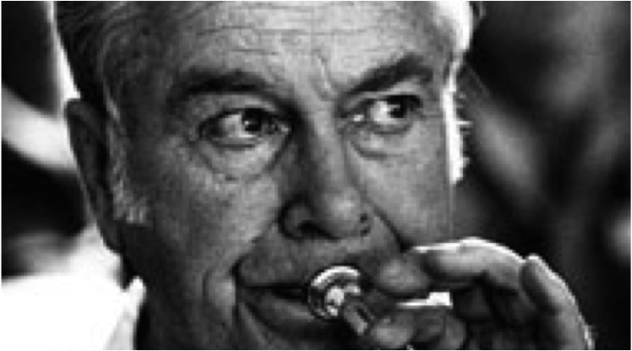
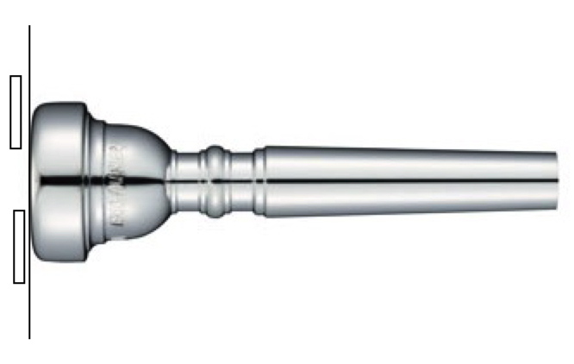
Trumpet Angle: Trumpet
The mouthpiece angle for trumpet is close to parallel. To do so you will need to slightly move the lower jaw forward.

Slide 17

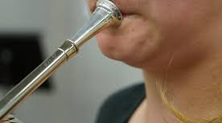
Mouthpiece Angle: Horn
In addition to the mouthpiece housing more of the top lip, the angle at which the mouthpiece meets the lips should be at around 45 degrees downward.

Slide 18
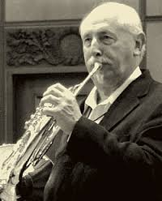
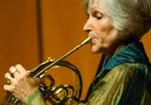
Mouthpiece Angle: Horn
This downward angle keeps the top lip free from pressure. Pressure inhibits vibration.

Slide 19
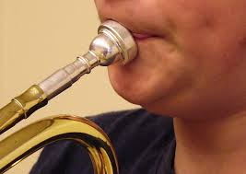
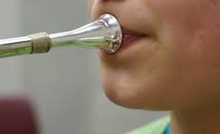
Incorrect Mouthpiece Angle
Trumpet:
Angle too low
Horn:
Angle too high

Slide 20
Anatomy: Trumpet & Horn
Trumpet
Trumpet is 4 feet of tubing
Cylindrical
As trumpet players progress, they play shorter trumpets
  Example: piccolo trumpet, 2 feet
Horn
Horn is 12 feet of tubing
Conical
As horn players progress they play higher and lower

Slide 21
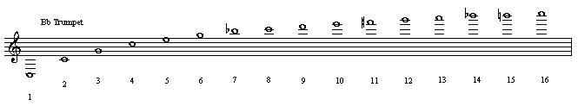

Overtone Series Comparison

Slide 22
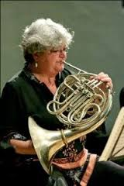
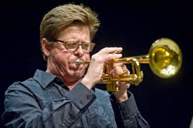
Sound Concept
The concept of sound should be quite different between
these two instruments.
Trumpets should look for a bright resonant sound that brilliant but not harsh.
Horns strive for a mellow, but not muffled tone.

Slide 23
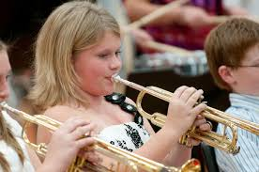
Teaching Beginners, Common Issues: Trumpet
Range: The trumpet is the highest brass instrument. It is important to start the trumpet player in the middle of his range (Concert F) and start building up.
Building up muscle memory: Beginner trumpet class needs to play on the mouthpiece regularly to build muscle memory.

Slide 24
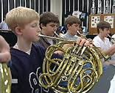
Teaching Beginners, Common Issues: Horn
Mouthpiece placement: Often placed too low on the embouchure.
Angle: Often not angled down enough
Chin: Chin can be “bunched” rather than flat

Slide 25
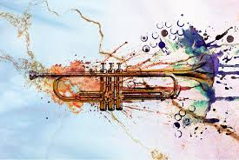
Scales: Trumpet
Many beginners trumpet players get frustrated with scales because of their range. I recommend to rearrange the order of the scales learned in class:
1st Concert Bb major
2nd Concert C Major
3rd Concert Ab major
4th Concert Eb major
5th Concert Db major
6th Concert D major
7th Concert G major (low range for last)
8th Concert F major (low range for last)

Slide 26
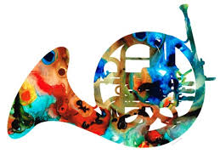
Scales: Horn
Horn players can play ALL
scales at least THREE octaves.
A common oversight when teaching
horn is not requiring them to play in the lower and
upper registers.
Go from the known to the unknown.
  Master one octave scale.
  Add lower octave descending, then ascending
  Add upper octave ascending, then descending

Slide 27
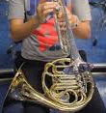
Switching Instruments
Practical reasons
  Beginner band may only consisting of Flute, Clarinet, and Trumpet.
  The full band instrumentation is recruited from these few instruments. Often the brass section recruited from the beginning trumpets.
Horn players want to be in jazz band.
  Trumpet seems a logical ticket into jazz band.

Slide 28
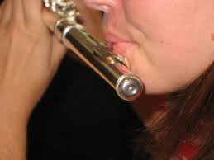
Options for Recruiting Horn Players from Another Section
Consider recruiting your horn players from the flute section.
The instruction for forming a flute embouchure, “say Pooh”, works well for horn also.
  Bottom lip is stabilized
  Angle of air is downward
  Corners engaged
  Flexible upper lip
  Comfortable with moving
  lots of air

Slide 29
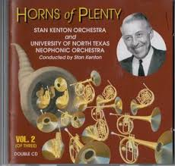
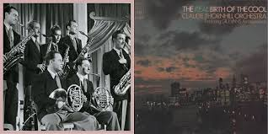
Horns in Jazz Band
YES!!!!

Slide 30

Horns in Jazz Band
Consider selecting repertoire with HORN PARTS.
  Example: Music of Stan Kenton, several modern jazz arrangements for concert band instrumentation in a jazz style
When horn parts are not available, give the horns a trombone part.
  Either write the part out in F.
  Or… even better…
  Have the horns learn to transpose this music at sight!

Slide 31
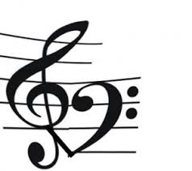
Horn Transposition
Trick
http://hornmatters.com/2008/07/transposition-tricks-bass-clef/
Change key signature.
  Example: Concert C would be G for horn players
Take the trombone line and change the bass clef to treble clef.
Read the part down one line or space (optional octave transposition).

Slide 32

Why Horn Transposition
This particular transposition is very beneficial for horn players AND band programs.
  Horn players use this transposition often in performances at church service. (given the tenor line of a hymnal)
  Learning to read down a step is a common transposition horn players must be able to do.
    Mozart Horn Concertos are in E-flat
  Since double reed instruments are often scarce in band programs, this skill enables horn players to play bassoon parts!

Slide 33
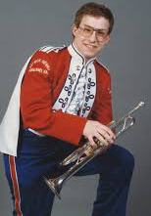
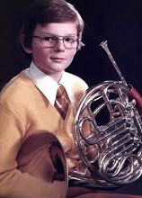
Conclusion
Trumpet and horn share many similarities.
Using identical pedagogical approach to teach both instruments can be damaging to the student.
These problems may not be immediately apparent but they will result in limited range and poor tone quality.
By the time these issues are such that they must be addressed, bad habits are ingrained and the students can have many days or years of frustration ahead.

Slide 34
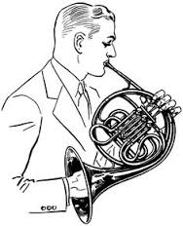

The Moral of our Story…
Paying particular attention to the slight but important differences in approach to these two instruments leads to long term success (and happiness) for these young musicians!

Slide 35
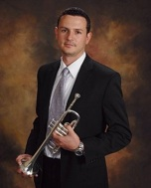

Thank you!
Dr. Etienne Stoupy www.etiennestoupy.com
etiennestoupy@gmail.com
Dr. Angela K. Winter
www.angelakwinter.com
angelakwinter@adams.edu

